Slide 1


Slide 2
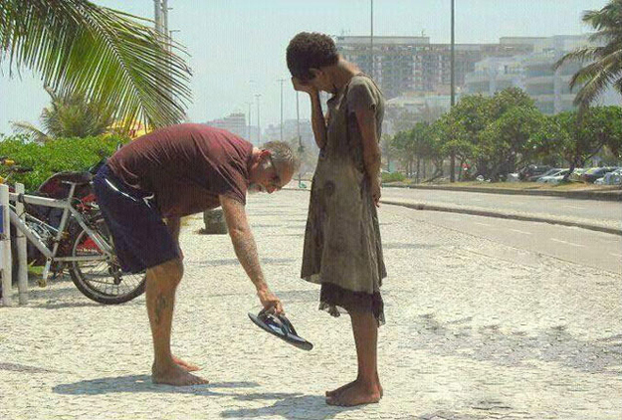
Step 1
We admitted we were powerless over our addictions and compulsive behaviors, that our lives had become unmanageable.
I know that nothing good lives in me, that is, in my sinful nature.
For I have the desire to do what is good, but I cannot carry it out. Romans 7:18 NIV

Slide 3
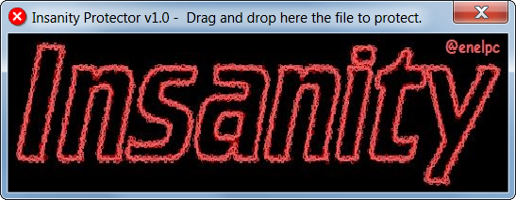
Belief
Repeat
Crash

Slide 4
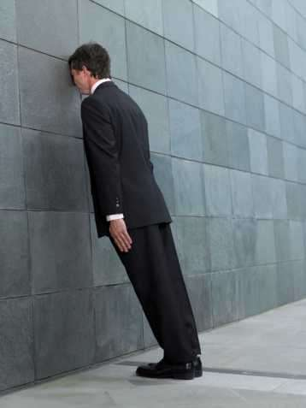

Slide 5


Slide 6
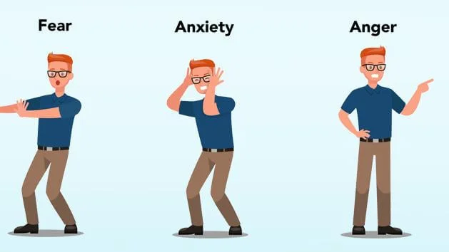

Slide 7


Slide 8
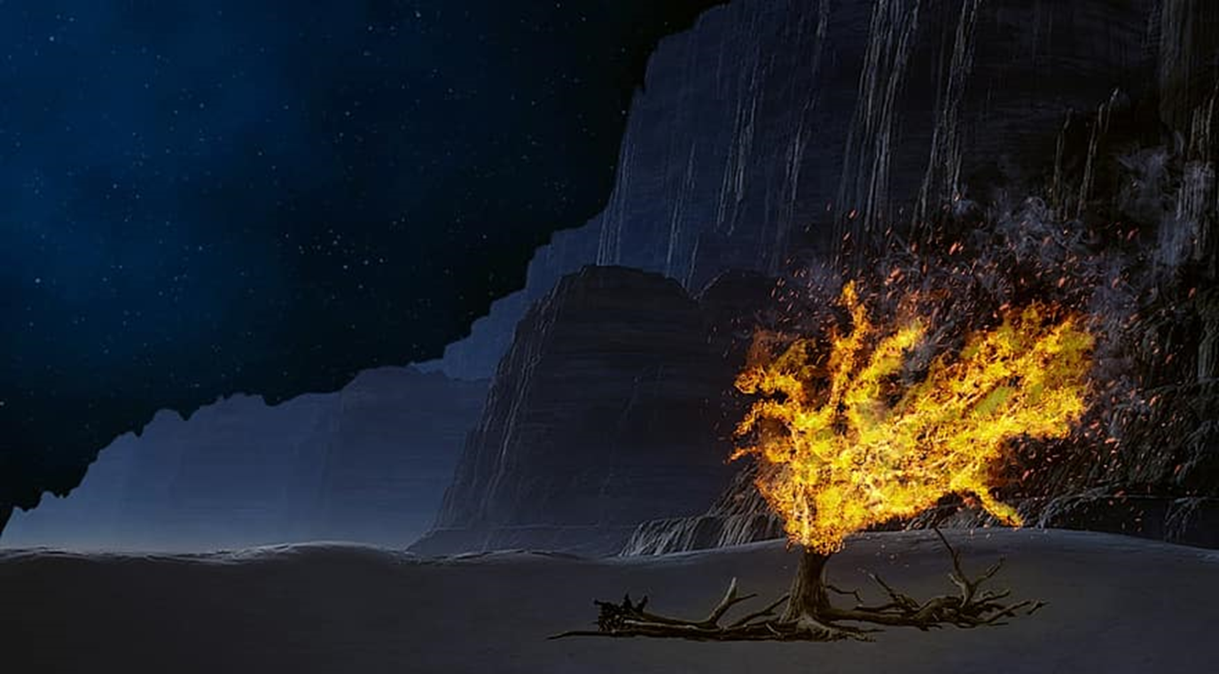

Slide 9


Slide 10
PROCESS TO SURRENDER
FEAR
ANXIETY
ANGER
BOTTOM
LOOK UP

